Slide 3
TALK 2
TRUE AUTHORITY!
The Authority & Inerrancy of the Bible
What does the Bible teach about itself?

Slide 4
LEARN THE IRISH BLESSING!

Slide 5
DIVISIONS OF THEOLOGY
The Doctrine of the Word of God
^{The Doctrine of God}
^{The Doctrine of Man}
^{The Doctrine of Christ}
The Doctrine of the Application of Redemption
^{The Doctrine of the Church}
^{The Doctrine of the Future}

Slide 6
ALL THE WORDS IN SCRIPTURE ARE GOD’S WORDS
“Thus says the Lord”

Slide 7
Numbers 22:38 ESV
“Balaam said to Balak, “Behold, I have come to you! Have I now any power of my own to speak anything? The word that God puts in my mouth, that must I speak.”

Slide 8
Deuteronomy 18:18-20 ESV
18 I will raise up for them a prophet like you from among their brothers. And I will put my words in his mouth, and he shall speak to them all that I command him. 19 And whoever will not listen to my words that he shall speak in my name, I myself will require it of him. 20 But the prophet who presumes to speak a word in my name that I have not commanded him to speak, or who speaks in the name of other gods, that same prophet shall die.’

Slide 9
2 Timothy 3:15-17 ESV
15 ...and how from childhood you have been acquainted with the sacred writings, which are able to make you wise for salvation through faith in Christ Jesus. 16 All Scripture is breathed out (THEOPNEUSTOS) by God and profitable for teaching, for reproof, for correction, and for training in righteousness, 17 that the man of God may be complete, equipped for every good work.”

Slide 10
2 Peter 1:21 ESV
“For no prophecy was ever produced by the will of man, but men spoke from God as they were carried along by the Holy Spirit.”

Slide 11
2 Peter 3:15-16 ESV
15 And count the patience of our Lord as salvation, just as our beloved brother Paul also wrote to you according to the wisdom given him, 16 as he does in all his letters when he speaks in them of these matters. There are some things in them that are hard to understand, which the ignorant and unstable twist to their own destruction, as they do the other Scriptures.

Slide 12
2 Timothy 5:18 ESV
For the Scripture says, “You shall not muzzle an ox when it treads out the grain,” and, “The laborer deserves his wages.”

Slide 13
John 14:26 ESV
“But the Helper, the Holy Spirit, whom the Father will send in my name, he will teach you all things and bring to your remembrance all that I have said to you.”

Slide 14
John 16:13 ESV
“When the Spirit of truth comes, he will guide you into all the truth, for he will not speak on his own authority, but whatever he hears he will speak, and he will declare to you the things that are to come.”

Slide 15
AS WE READ
WE ARE CONVINCED

Slide 16
SCRIPTURE WAS NOT
GIVEN BY DICTATION

Slide 17
AUTHORITY CLARIFIED

Slide 18
TEAM WORK
If we deny that the whole Bible is true, but only parts of it are true, what problems do we face?
If we have a problem understanding a particular passage in the Bible, what should a man do?
If a man gives attention to studying these doctrines now, how will they help you be man of influence and a true spiritual leader in times to come? (An elder at the gate!)
What Bible passages or doctrines are difficult for you to understand right now? Do any topics pop up in your mind as particularly troublesome to you right now? Feel free to give your feedback to Pete so he can address (PeteAlwinson@ForgeTruth.Com)

Slide 22
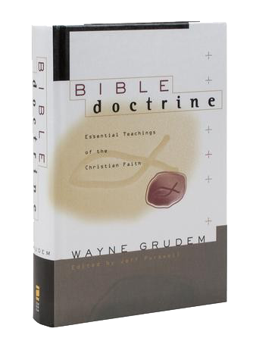
If you want to dive in and go deep, get this book!

