Slide 2
TALK 1
EVERY MAN
A THEOLOGIAN

Slide 3
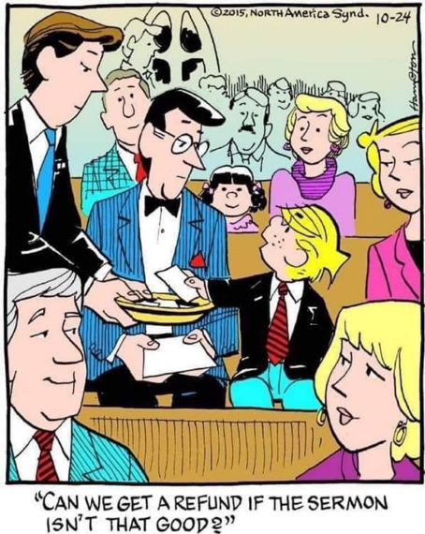
TALK 1
EVER MAN
A THEOLOGIAN

Slide 4
1 Timothy 1:1-7 NASB
1 Paul, an apostle of Christ Jesus according to the commandment of God our Savior, and of Christ Jesus, who is our hope,
² To Timothy, my true son in the faith: Grace, mercy, and peace from God the Father and Christ Jesus our Lord. ³ Just as I urged you upon my departure for Macedonia, to remain on at Ephesus so that you would

Slide 5
instruct certain people not to teach strange doctrines, ⁴ nor to pay attention to myths and endless genealogies, which give rise to useless speculation rather than advance the plan of God, which is by faith, so I urge you now. ⁵ But the goal of our instruction is love from a pure heart, from a good conscience, and from a sincere faith. ⁶ Some people have strayed from these things and have turned aside to fruitless discussion,

Slide 6
⁷ wanting to be teachers of the Law, even though they do not understand either what they are saying or the matters about which they make confident assertions.”

Slide 7
1 Timothy 3:1-6 NASB
3 It is a trustworthy statement: if any man aspires to the office of overseer, it is a fine work he desires to do. ² An overseer, then, must be above reproach, the husband of one wife, temperate, self-controlled, respectable,
hospitable, skillful in teaching, ³ not overindulging in wine, not a bully, but gentle, not contentious, free from the love of money.

Slide 8
⁴ He must be one who manages his own household well, keeping his children under control with all dignity ⁵ (but if a man does not know how to manage his own household, how will he take care of the church of God?), ⁶ and not a new convert, so that he will not become conceited and fall into
condemnation incurred by the devil.”

Slide 9
1 Timothy 4:1-5 NASB
⁴ But the Spirit explicitly says that in later times some will fall away from the faith, paying attention to deceitful spirits and teachings of demons, ² by means of the hypocrisy of liars seared in their own conscience as with a branding iron, ³ who forbid marriage and advocate abstaining from foods which God has
created to be gratefully shared in by those who

Slide 10
believe and know the truth. ⁴ For everything created by God is good, and nothing is to be rejected if it is received with gratitude; ⁵ for it is sanctified by means of the word of God and prayer.”

Slide 11
1 Timothy 4:6-13 NASB
⁶ In pointing out these things to the brothers and sisters, you will be a good servant of Christ Jesus, constantly nourished on the words of the faith and of the good doctrine which you have been following. ⁷ But stay away from worthless stories that are typical of old women. Rather, discipline yourself for the purpose of godliness;

Slide 12
⁸ for bodily training is just slightly beneficial, but godliness is beneficial for all things, since it holds promise for the present life and also for the life to come. ⁹ It is a trustworthy statement deserving full acceptance. ¹⁰ For it is for this we labor and strive, because we have set our hope on the living God, who is the Savior of all mankind, especially of believers.

Slide 13
¹¹ Prescribe and teach these things. ¹² Let no one look down on your youthfulness, but rather in speech, conduct, love, faith, and purity, show yourself an example of those who believe.
¹³ Until I come, give your attention to the public
reading, to exhortation, and teaching.”

Slide 14
WHAT IS “DOCTRINE” & “THEOLOGY”
^{Definitions are crucial!}

Slide 15
SYSTEMATIC THEOLOGY
“What the whole Bible teaches us today on any given topic.”
^{-Wayne Grudem and John Frame}

Slide 16
BIBLICAL THEOLOGY
^{Old Testament Theology –}
^{New Testament Theology –}
^{Bible Book Theology}

Slide 17
WHAT ARE THE 7 MAJOR DOCTRINES OF THE BIBLE?

Slide 18
7 MAJOR DOCTRINES
The Doctrine of the Word of God
^{The Doctrine of God}
^{The Doctrine of Man}
^{The Doctrine of Christ}
The Doctrine of the Application of Redemption
^{The Doctrine of the Church}
^{The Doctrine of the Future}

Slide 19
WHY STUDY DOCTRINE & THEOLOGY?

Slide 20
HOW SHOULD WE STUDY THE BIBLE?
Prayerfully --- Humbly --- Rationally
^{Communally --- Worshipfully}

Slide 21
TEAM WORK
What terms used today are you still not clear about? (Doctrine, Theology, Systematic Theology, Old Testament Theology, New Testament Theology, Biblical Theology.) Try to clarify around the table.
Have you ever been in a situation where people looked to you for Biblical answers to a topic or real-life situation and you didn’t have them? What did you do or say? Would you have like to have had the answers?
Imagine & Discuss: What would it be like if every Christian man/husband/father had a strong grasp on what the Bible teaches in the 7 major doctrinal areas of the Bible. How would this positively affect families and churches and our culture?
Pray around the table that the positives might be accomplished!

